Slide 1
What is shared data problem?
The shared data problem occurs when several functions (or ISRs or tasks) share a variable.
Shared data problem can arise in a system when another higher priority task finishes an operation and modifies the data or a variable before the completion of previous task operations.

Slide 2
Steps to eliminate shared data problem:
i)Use modifier volatile with declaration from variable that returns from interrupt. It warns the compiler that certain variables may modify.
ii) Use reentrant function with atomic instructions that needs its complete execution before it can be interrupted. This part is called critical section.
iii) Put a shared variable in a circular queue. The function that requires the value takes it from queue front. The function that inserts (writes) the value takes it at the queue back.

Slide 3
Contd..
iv) Disable the interrupts before critical section starts executing and enable the interrupts on its completion. Even the high priority interrupts than the critical section gets disabled.

Slide 4
Application of semaphores in shared data problem
Mutex is semaphore that provides at an instance two tasks mutually exclusive access the resources and is used in solving shared data problem.
Semaphores does not eliminate shared data problem completely.
Drastic option of disabling interrupts in all critical sections by using semaphores cannot be done.
When using semaphores, OS does not disable interrupt.
Task switching flags can be used.

Slide 5
Reentrancy:
Reentrancy came from the mainframe era.
In the embedded world a routine must satisfy the following conditions to be reentrant:
It uses all shared variables in an atomic way, unless each is allocated to a specific instance of the function.
It does not call non-reentrant functions.
It does not use the hardware in a non-atomic way.

Slide 6
Atomic variables
Both the first and last rules use the word atomic, which comes from the Greek word meaning indivisible.
In the computer world, atomic means an operation that cannot be interrupted.
mov ax,bx
Since nothing short of a reset can stop or interrupt this instruction, it's atomic.
It will start and complete without any interference from other tasks or interrupts.

Slide 7
Contd..
The first part of Rule requires the atomic use of shared variables. Suppose two functions each share the global variable foobar.
temp = foobar;
temp += 1;
foobar = temp;
This code is not reentrant, because foobar is used non-atomically.
That is, it takes three statements to change its value, not one. The foobar handling is not indivisible.

Slide 8
Contd..
Global Variable:
int foo; void some_function(void) { foo++; }
Local Variable:
void some_function(void) { int foo; foo++; }

Slide 9
Code reentrant
What are our best options for eliminating non-reentrant code?
The first rule is to avoid shared variables
Use automatic variables or dynamically allocated memory(like malloc ,calloc in C).
Disadvantages:
With interrupts off, the system suddenly becomes a single-process environment. There will be no context switches.
Shutting interrupts down does increase system latency, reducing its ability to respond to external events in a timely manner.

Slide 10
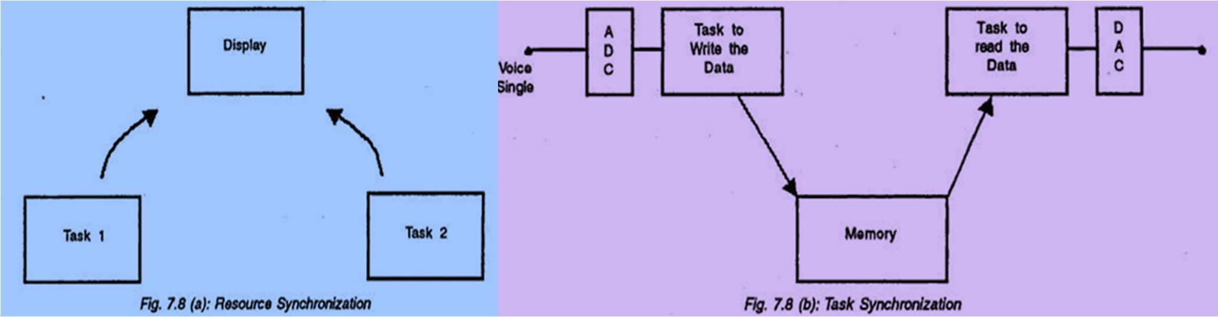
SEMAPHORES
A semaphore is nothing but a value or variable or data which can control the allocation of a resource among different tasks in a parallel programming environment.
The concept of semaphore was first proposed by the Dutch computer scientist Edsger Dijkstra in the year 1965.
So, Semaphores are a useful tool in the prevention of race conditions and deadlocks; however, their use is by no means a guarantee that a program is free from these problems.
Task1 wants to display “Temperature is 50” Task2 wants to display “Humidity is 40%”
Task1 wants to write the ADC data into memory. Task2 wants to read the data into memory.

Slide 11
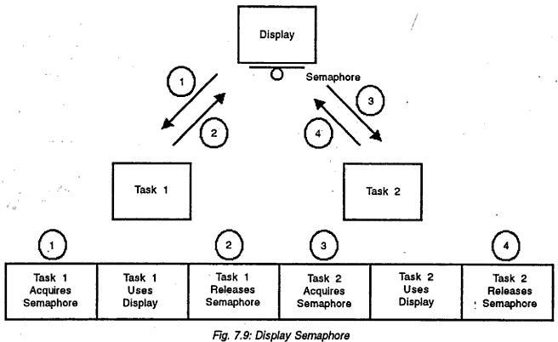
SEMAPHORES…..

Slide 12
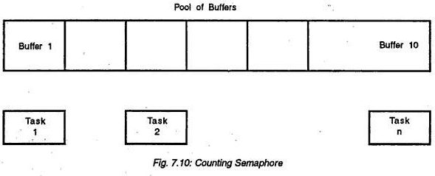
SEMAPHORES…..
More no. of Tasks wants to access the same resource, then tasks are kept in queue. Pool of 10 buffers is available, so any task can Write to a buffer.
The initial value is 10, and whenever a task acquires the semaphore the value is decremented by 1, if it reaches 0 then the shared resource is no longer available.
For 8 bit integer semaphore can take value between 0 to 255.

Slide 13
SEMAPHORES…..
Semaphores are system-implemented data structures that are shared between processes.
Features of Semaphores:
Semaphores are used to synchronize operations when processes access a common, limited, and possibly non-shareable resource.
Each time a process wants to obtain the resource, the associated semaphore is tested. A positive, non-zero semaphore value indicates the resource is available.
Semaphore Operations:
wait: P(S) → P from Dutch proberen, to test
wait tests semaphore value, and if false, sets to true
wait has two parts- test and set, which must occur together atomically
signal: V(S) → V from Dutch verhogen, to increment
sets value to false
Semaphore Control
get info on a set
set all semaphore values in a set or get all values
set one value in a set or get one value
remove the set

Slide 14
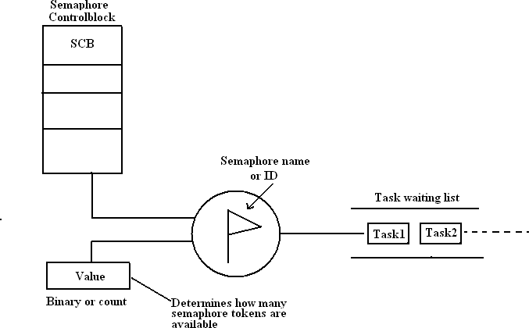
SEMAPHORES…..

Slide 15
SEMAPHORES…..
Semaphore Operations…
wait (aSemaphore)
if aSemaphore’s counter > 0 then
decrement aSemaphore’s counter
else
put the caller in aSemaphore’s queue
attempt to transfer control to some ready task
(if the task ready queue is empty, deadlock occurs)
end
release(aSemaphore)
if aSemaphore’s queue is empty (no task is waiting) then
increment aSemaphore’s counter
else
put the calling task in the task ready queue transfer control to a task from aSemaphore’s queue
end
Example of semaphore:
Producer and consumer problem
The producer should stop producing when the warehouse is full. The consumer should stop consuming when the warehouse is empty

Slide 16
SEMAPHORES…..
Semaphore Management Function Calls:
Create a semaphore
Delete a semaphore
Acquire a semaphore
Release a semaphore
Query a semaphore

Slide 17
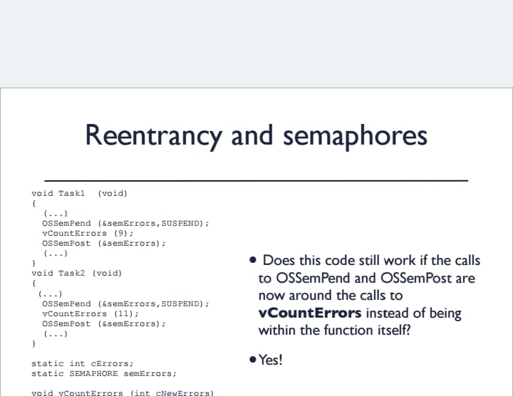

Slide 18
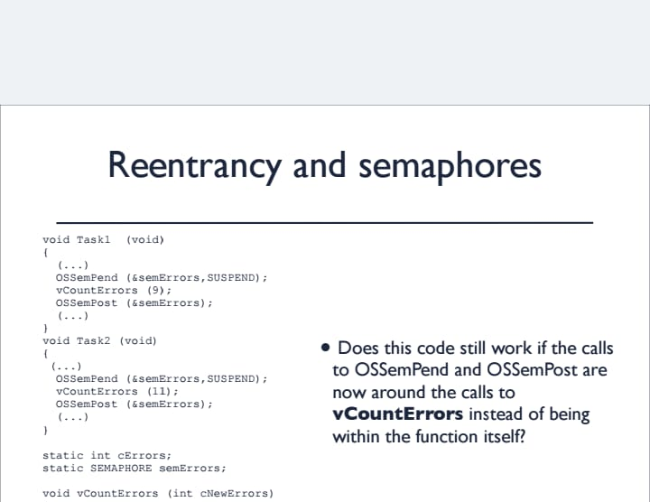

Slide 19
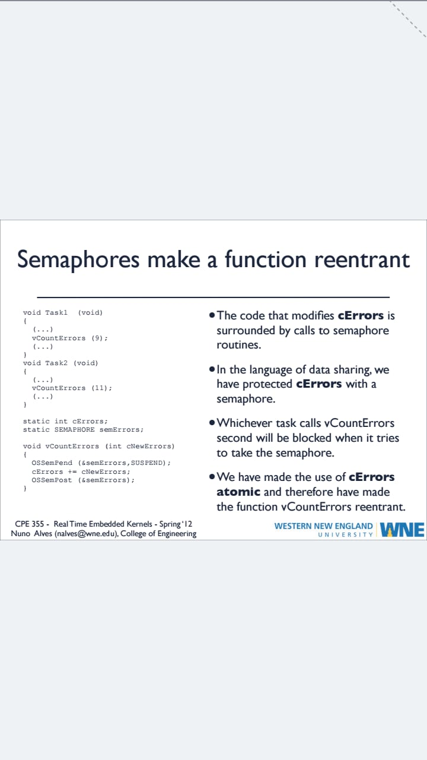

Slide 20
MUTEX (Mutual Exclusion)
Mutex means mutual exclusion. A mutex is a synchronization object that can have only two states. They are not-owned and owned.
Two operations are defined for mutexes.
Lock: This operation attempts to take ownership of a mutex, if the mutex is already owned by another thread then the invoking thread is queued.
Unlock: This operation relinquishes ownership of a mutex. If there are queued threads then a thread is removed from the queue and resumed, ownership is implicitly assigned to the thread.
Mutex is basically a locking mechanism where a process locks a resource using mutex. As long as the process has mutex, no other process can use the same resource. Once process is done with resource, it releases the mutex. Here comes the concept of ownership. Mutex is locked and released by the same process/thread.
Most RTOSs implement this protocol in order to address the Priority Inversion problem. Semaphores can also handle mutual exclusion problems but are best used as a communication mechanism between threads or between ISRs and threads.

Slide 21
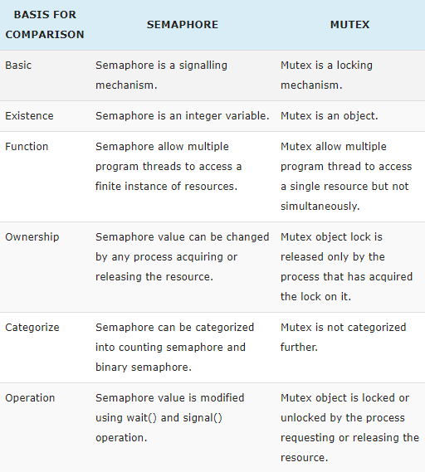
MUTEX (Mutual Exclusion)…..

Slide 22
Mutex…..
Mutex Management Function Calls:
The OS functions calls provided for mutex management are
Create a mutex
Delete a mutex
Acquire a mutex
Release a mutex
Query a mutex
Wait on a mutex

Slide 23


